Slide 1
Business, Marketing, Entrepreneurship, Digital Marketing, and Econ Mrs. Schafer

Slide 2
Interviewing
Types of Interviews
Interview Activity

Slide 3

Interviews in the Past?
Have you ever been interviewed before? When/where?
Have you ever interviewed someone else before? For a school project? As part of work?
Best way to become a good interviewee is to give a lot of interviews yourself (as the interviewer)
Best interviews?
Worst interview?
Practice handshakes (not too limp, not too long
sweaty/slimy? grip too tight?)
Notes:
Break into pairs to discuss this together

Slide 4
Interviewee Best Practices
1. Do your research (on the company and the interviewers)
2. Look sharp
3. Show up with something in your hands
4. Arrive early
5. Project enthusiasm
6. Listen carefully
7. Give specific examples that show impact
8. Ask questions
9. End on the right note
10.Ace the follow-up
* Mrs. Schafer’s personal tip (Who you know): talk about a person who connected you to the job whom both interviewee and interviewer know, perhaps someone who already works there or goes there. Have to be really careful with this, as it’s tricky. Is that person well-respected? Is tying yourself to them a good or bad thing? Does the interviewer really know that individual?
Notes:
1. Do your research on the company and the people interviewing you
Learning as much as possible about a company’s services, products, customers and competition will give you an edge in understanding and addressing the employer’s needs,
Go beyond reading what’s on the company’s website. Read news coverage of the company, check out the company’s social media feeds, and brush up on the key players—i.e., the company’s executive team.
“Look for the information that you can weave into the conversation. (“I was excited to see your CEO talk about your company’s commitment to innovation on CNBC.”)
2. Look sharp
Unless you work in a creative industry, the employer wants to know that you dress professionally “As long as you look presentable, the interviewer is going to be paying attention to what’s coming out of your mouth, not what you’re wearing.” And no matter what industry you’re in, employers want to know they can one day put you in front of a client or investor.
3. Don't show up empty handed
Part of arriving fully prepared entails bringing all the things that you need to make a great first impression. Make sure to take the following items with you to job interviews:
Several copies of your resume. You may meet more employees that you originally expected to, Portfolio/work samples. This is a must in creative fields like advertising, journalism, graphic design, architecture, or fashion.
Pen and notepad. Taking notes shows you’re actively listening to the interviewer and engaged in the conversation.
Photo ID. You may need to provide identification to enter the building. If online, be prepared to send your latest version of your resume to interviewers after the meeting.
4. Arrive early
The last thing you want to do is show up late (or not at all), says Martin, so get to the building 10 to 15 minutes before the interview. Moreover, “having extra time means you can take a few minutes in the bathroom to check how you look—tuck in your shirt, fix your tie, comb your hair—and fine-tune the image that you want to present
5. Project enthusiasm
The hiring manager will want to see that you’re passionate about your field and the job that you’re applying for, so bring some energy to the room. “A firm handshake and plenty of eye contact demonstrate confidence,” Martin adds. “Speak distinctly in a confident voice, even though you may feel shaky.”
6. Listen carefully
Learning how to listen—really listen—is a powerful thing. Some ground rules to follow: don’t interrupt when the other person is talking; maintain good eye contact, lean forward, and face the speaker directly; and put away your cellphone
7. Give specific examples
Select anecdotes that highlight quantifiable achievements. Show the value in what you did. What impact did it make? (“I’m highly self-motivated. In fact, recently our budgeting system didn’t pass muster for the sophisticated reporting we needed to do. I took the initiative to do some research and found an alternative that was 25% cheaper that integrated with our other software and could be implemented within six weeks.”)
8. Ask questions
Hiring managers often conclude job interviews by giving the candidate a chance to ask them questions.
A few recommendations:
Why is this position open?
What do you enjoy most about working here?
How is performance measured in this role?
If you can’t think of other question to ask, a great one I’ve done is “what do you think I should ask that I haven’t yet asked.”
Or what do you love about working here? And if there was one thing you’d change if you had complete control, what would it be?
9. End on the right note
An essential step to nabbing a job is following up with the interviewer. “Your last question during an interview should always be, ‘What are the next steps from here?’
Never ask…did I get the job? Makes you seem desperate and without any EQ
10. Ace the follow-up
Following up is a critical part to getting hired, yet it's often overlooked. The goal is two-fold: to stay top-of-mind and restate your interest. For example: “Hi Tom, it was great to meet you today. Please let me know if I can offer any additional information, such as letters of recommendation, that might be useful.”
Want more interviews? Do this
It's important to appear confident and cool for the interview. One way to do that is to go on an ample number of interviews so you get comfortable with the process

Slide 5
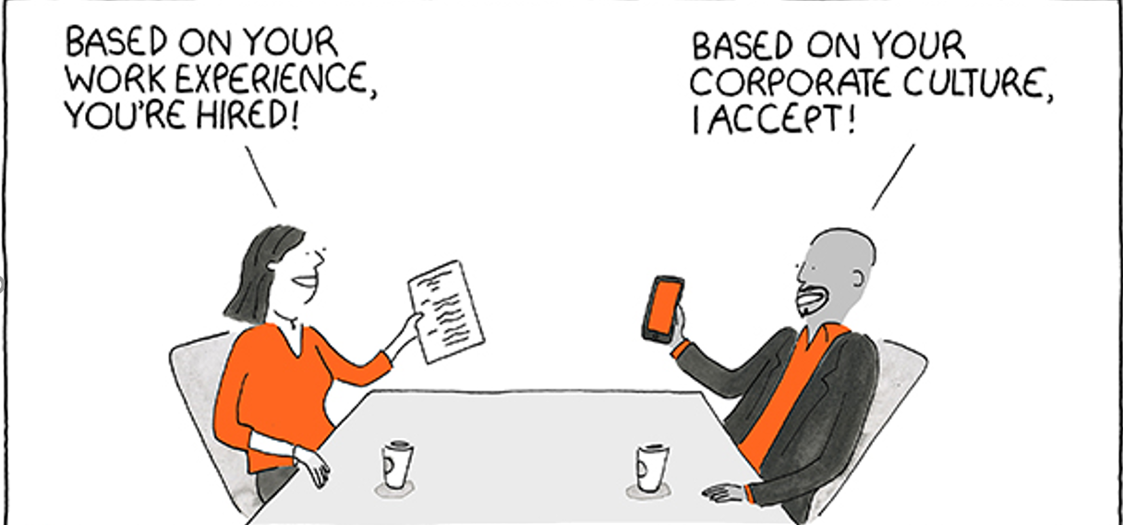
Types of interviews
Types of Interviews
Assessment
-Do this test/show what you know
Case
-short period of time to assess information, ask follow-ups, and give recommendation
Behavioral
-Scenario-based
-If x happens, what would you do?
Background
-Off of your resume
Notes:
Research online and find some questions that could be asked for each of these interviews

Slide 6
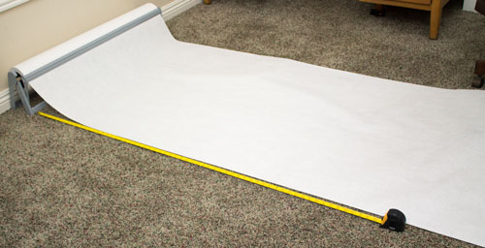
In-class Activity
Break-up class into groups of 3: I’ll assign you a type of interview: Behavioral, Assessment, Case, Background
Research online: what are typical questions that could be asked for these 4 types of interviews
Write the definition of that kind of interview and possible interview questions onto your large sheet of paper. Make the poster look nice! It’s going in the hallway!

